Slide 1
Character Sets
Supplement to DDL Lecture(s)

Slide 2
Outline
Character
Bits and Bytes
Control Characters
Graphic/Printing Characters
Character Sets
Bit Sequence
Collating Sequence
Unicode
ASCII

Slide 3
Character
Unique bit pattern
That has an assigned meaning
Eg. 100 0001: A 100 0010: B

Slide 4
Bits and Bytes
The number of bytes that are used in the character set determines the number of bits that are available. The more bits, the more patterns that are available.
1 byte = 8 bits = 256 unique patterns 7 bits = 128 patterns 2 bytes = 16 bits = 65,536

Slide 5
Control Characters
In the olden days, communications equipment (telegraph, teletype, …) relied on ‘control characters’ that were embedded in the data stream to control some aspects of the receiving device.

Slide 6
Control Characters
[CTRL-G] ring the bell
[CTRL-D] end of transmission
[CTRL-H] backspace
[CTRL-J] line feed
[CTRL-L] form feed (eject to top of new form)
[CTRL-M] carriage return

Slide 7
Graphic / Printing Characters
Letters of the alphabet
Digits in the number system
Special characters (punctuation)
Everything that isn’t a control character

Slide 8
Character Set
Set of bit patterns
To which characters have been assigned

Slide 9
Bit Sequence
0000000 low
1111111 high

Slide 10
Collating Sequence
An established sequence for the character set. For example, the alphabetizing scheme.
The character set usually maps directly to the collating sequence.

Slide 11
Unicode
ISO standards group
Vendor and user groups
Combined solution for the Universal Character Set
In SQL:1999, all special characters are defined in terms of Unicode.

Slide 12
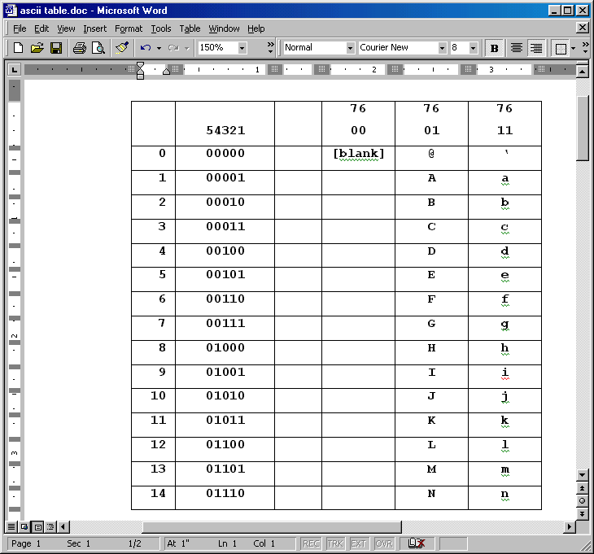
ASCII Table – Part 1

Slide 13
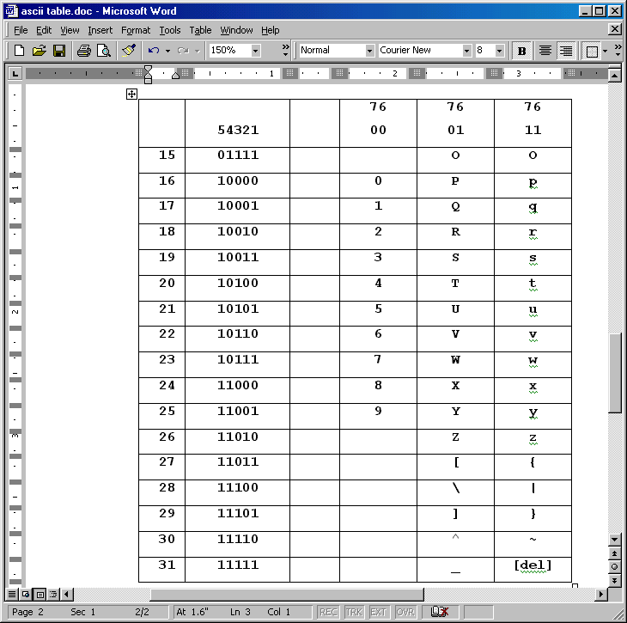
ASCII Table – Part 2

Slide 14
Problem
Show all employees whose last name starts with a letter between A and M.
Select last_name from employee where last_name between (‘A’ and ‘Mz’)

Slide 15
Character Set SQL:1999
CREATE TABLE alphabets ( alph_latin CHARACTER(12) CHARACTER SET LATIN1, alph_ascii CHARACTER(20) CHARACTER SET ASCII, alph_kanji CHARACTER(20) CHARACTER SET KANJI)

Slide 16
Comments / Questions

